Slide 1

Myntra analysis
Indian E-commerce company
Subiksha S | MBE 11

Slide 2

Company profile
Ownership:
Acquired by Flipkart in 2014 (part of Walmart Group)
Business model:
Online fashion and lifestyle retailer, primarily operating on a B2C model.
Founded:
2007, India

Slide 3

Business model
Myntra operates primarily on a B2C (Business-to-Consumer) e-commerce model, specializing in fashion and lifestyle products. Its business model is multi-faceted, encompassing different revenue streams, partnerships, and strategies.

Slide 4

Market position and growth
1
Leading Fashion E-commerce Platform
2
Wide Product Offering
3
Strong Digital Presence
4
Brand Partnerships & Private Labels
5
Seasonal Sales Leadership

Slide 5

Growth factors
Expanding Customer Base
This geographic expansion is crucial for long-term growth, with these regions driving substantial new customer acquisition.
Mobile-First Strategy
Technology & Personalization
Myntra uses AI and machine learning to enhance personalization, offering tailored recommendations based on user preferences, shopping history, and browsing patterns.
The Myntra mobile app, with its user-friendly design and AI-powered personalized recommendations, ensures high engagement and repeat purchases.

Slide 6


Growth Trajectory
Myntra’s GMV growth has been constantly outpacing the market, touching 2X of the online fashion market growth in the festive season
Integral to this growth has been the 33% surge in Monthly Active Users (MAU), rising from ~45 million in 2021 to an impressive ~60 million by the end of 2023
Brands on Myntra have recorded a strong year-on-year (YoY) growth, with the catalogue size on the platform also having grown by over 50% in the last year

Slide 7

Myntra’s revenue model
Myntra said its operating revenue grew 25% to Rs 4,375 crore in the financial year ended March 31, 2023, even as loss widened by 31% to Rs 782 crore in the same period.

Slide 8

Total operating revenue
The firm had reported Rs 3,501 crore in operating revenue in the previous fiscal year, while incurring a loss of Rs 597 crore, according to filings sourced through business intelligence platform Tofler.
Total expenses in FY23 rose to Rs 5,290 crore from Rs 4,206 crore.

Slide 9


Advertising revenue
Myntra, which sells apparel, accessories and footwear among other products, spent Rs 1,758 crore in advertising and promotional expenses in FY23, a 35% increase from the year before. This was the biggest contributor to its total expenses. It spent Rs 631 crore in employee expenses against Rs 522 crore in FY22.
Myntra has been experimenting with new features and verticals like FWD and Myntra Minis to increase the app’s usage and attract new customers like those from the GenZ age group.

Slide 10

Technology utilization
1
2
3
Artificial Intelligence (AI) & Machine Learning (ML)
Data Analytics
Augmented Reality & Virtual Try-On

Slide 11


Artificial intelligence and machine learning
Personalized Recommendations
Search and Filter Optimization
Visual Search

Slide 12


Data analytics
01
Customer Insights
02
Inventory and Demand Forecasting

Slide 13

Augmented Reality & Virtual Try-On
Virtual Try-On Features Myntra Studio

Slide 14
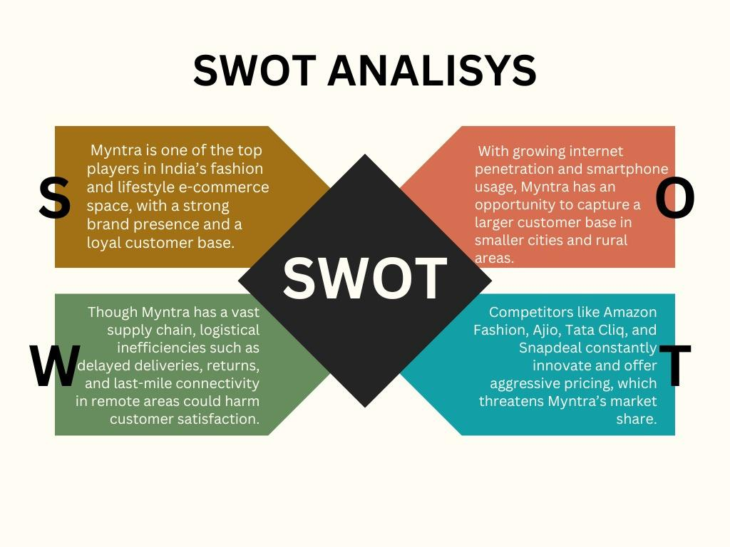

Slide 15


Strengths
Market Leadership in Fashion E-commerce
Strong Product Portfolio
Exclusive Brands & Private Labels
End of Reason Sale

Slide 16


Weakness
High Return Rates
Limited Offline Presence
Dependency on Discounts
Profitability Challenges

Slide 17


Sustainability and Ethical Fashion
Omnichannel Strategy
Opportunities
Expansion into Tier 2 and 3 Cities
International Expansion

Slide 18

Threats
Logistics and Delivery Challenges
Intense Competition
Customer Retention Issues
Rising Operational Costs

Slide 19
Customer sentiment analysis

Slide 20



Customer reviews on social media
1
2
3
High impact reviews
Medium impact reviews
Low impact reviews

Slide 21
High impact reviews
Medium impact reviews
Long-term user experience and specific content request.
Request for niche product (plus-size clothing), potentially influencing product focus
Suggestion for a specific type of product (V-neckkurta).
Request for specific audience- targeted content
Low impact reviews
General positive comment, but no specific feedback

Slide 22


Strategic
recommendations

Slide 23


Strategic recommendations based on the customer reviews
Expand plus-size clothing range.
Curate college wear collection.
Targeted sales & promotions for Long-term users.
Enhanced content marketing strategy.
Better product description and videos.

Slide 24

Areas need to improve based on customer reviews
1
Delayed or missing deliveries
2
Faulty return and refund policies
3
Product quality issues
4
Lack of accountability
5
Poor customer service

Slide 25

Common market trends identification
Increased demand for sustainable fashion
Rise of online shopping in tier-2 and tier- 3 cities
Growing popularity of athleisure and loungewear
Personalized shopping experiences through AI

Slide 26
Major competitors
Competitive analysis
Ajio
Amazon
Nykaa fashion

Slide 27
Recommendations based on competitors
Strengthen omnichannel strategy.
Expand ethnic and regional offerings.
Leverage private labels and In-house brands.
Invest in sustainability initiatives.

Slide 28

Influencer-driven and social commerce expansion.
Improve customer service and delivery logistics.
Enhance technology for Virtual Try-On and AR.
Expand premium and luxury segment.

Slide 29
Thank you!

